Slide 1





WELCOME
TO THE
HALF-TIME
HUSTLE
JUN
28
2024
9:00 - 12:00
IT’S GAME
TIME
HALF TIME
1 - 20
AGENT
ACTIVITIES

Slide 2
WI4C2TES
WIN-WIN or no deal
INTEGRITY do the right thing
CUSTOMERS always come first
COMMITMENT in all things
COMMUNICATION seek first to understand
CREATIVITY ideas before results
TEAMWORK together everyone achieves more
TRUST starts with honesty
EQUITY opportunities for all
SUCCESS results through people

Slide 3
My BIG Why
The BIG Why is about having a purpose, a mission, or a need that in turn gives you focus. -The MREA
What is your BIG Why?

Slide 4
The GAP & the GAIN
IDEAL
WHERE I AM NOW?
WHERE I STARTED?

Slide 5
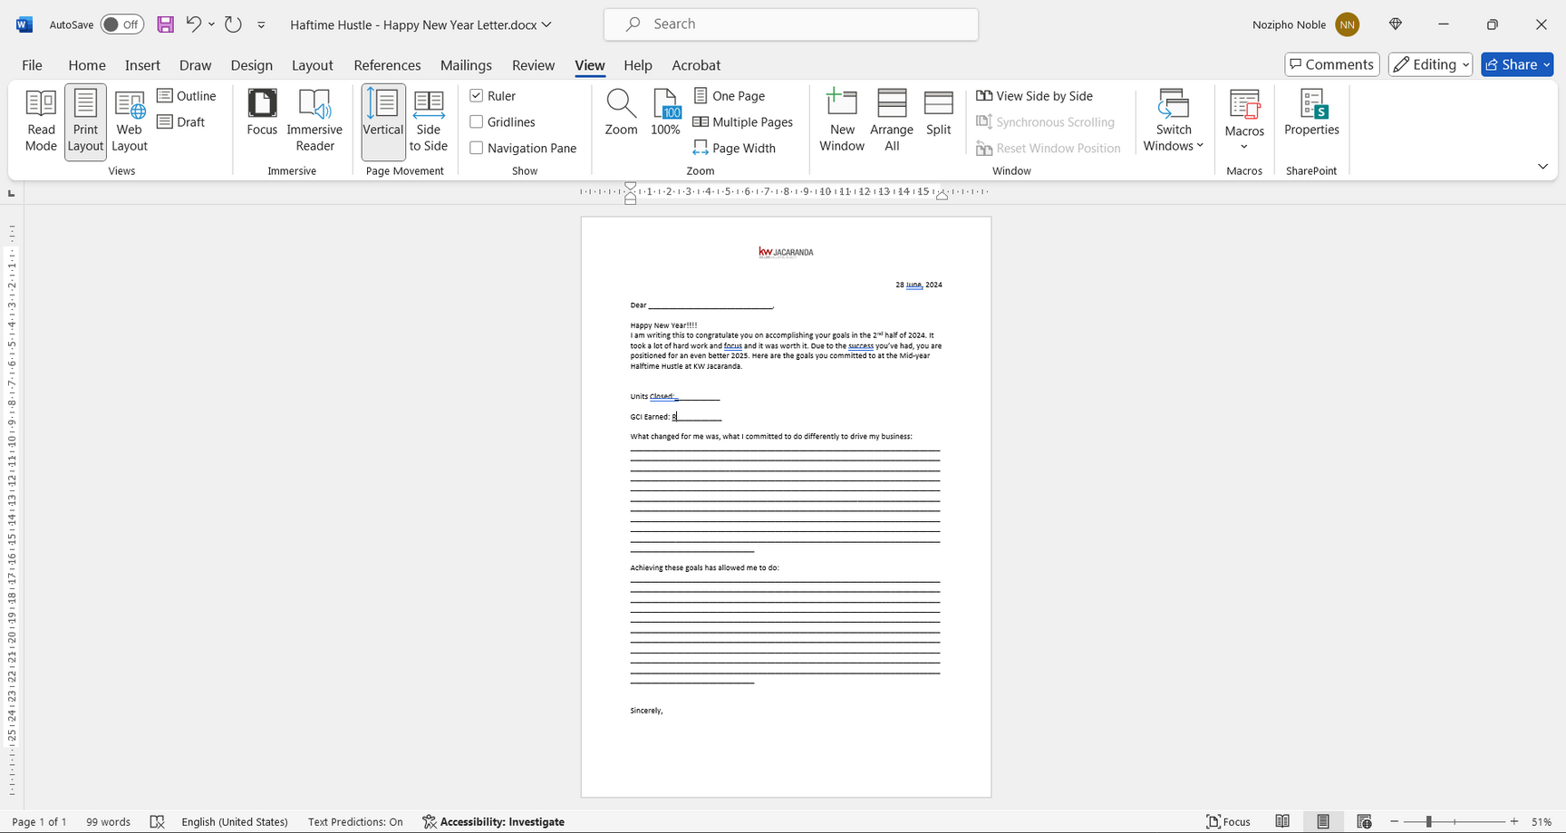
Your DREAM

Slide 6
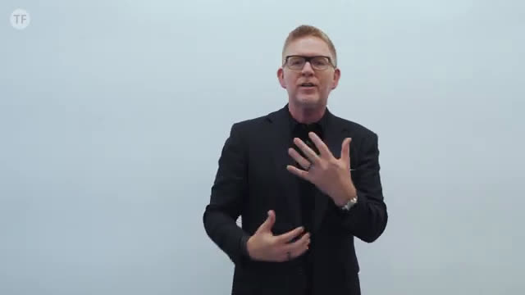
Video

Slide 7
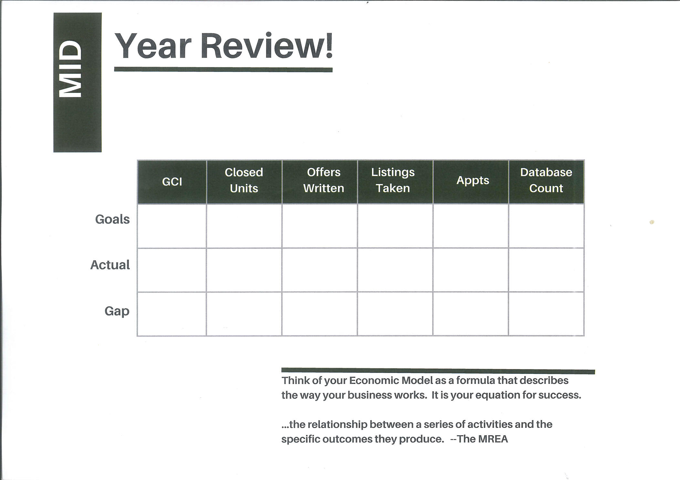
Mid-Year Review
MARKET CENTRE
R10,000 000
480
360
600
R1,851 421
58
73
400
R8, 148 579
422
287
200
  More listings
  18% sold - sell more listings
  Share more deals - work together
  80% - Buyer + Seller
  20% - Shared

Slide 8
Mid-Year Review
HENNI PORTWIG
R1,000 000
22
24
48
240
100%
12 Months
6 Months
R500 000
11
12
24
120
2400
R923 000
14
17
13
160
Top Up
+R218 000
+3
+5
-11
+40
Top Up
HENNI’s 2024 GOALS:
  Capping
  MREA Millionaire
  TOYOTA Fortuner
RECOMMENDATION:
  15-20 appointments a month!

Slide 9
Mid-Year Review
(What are my numbers?)

Slide 10
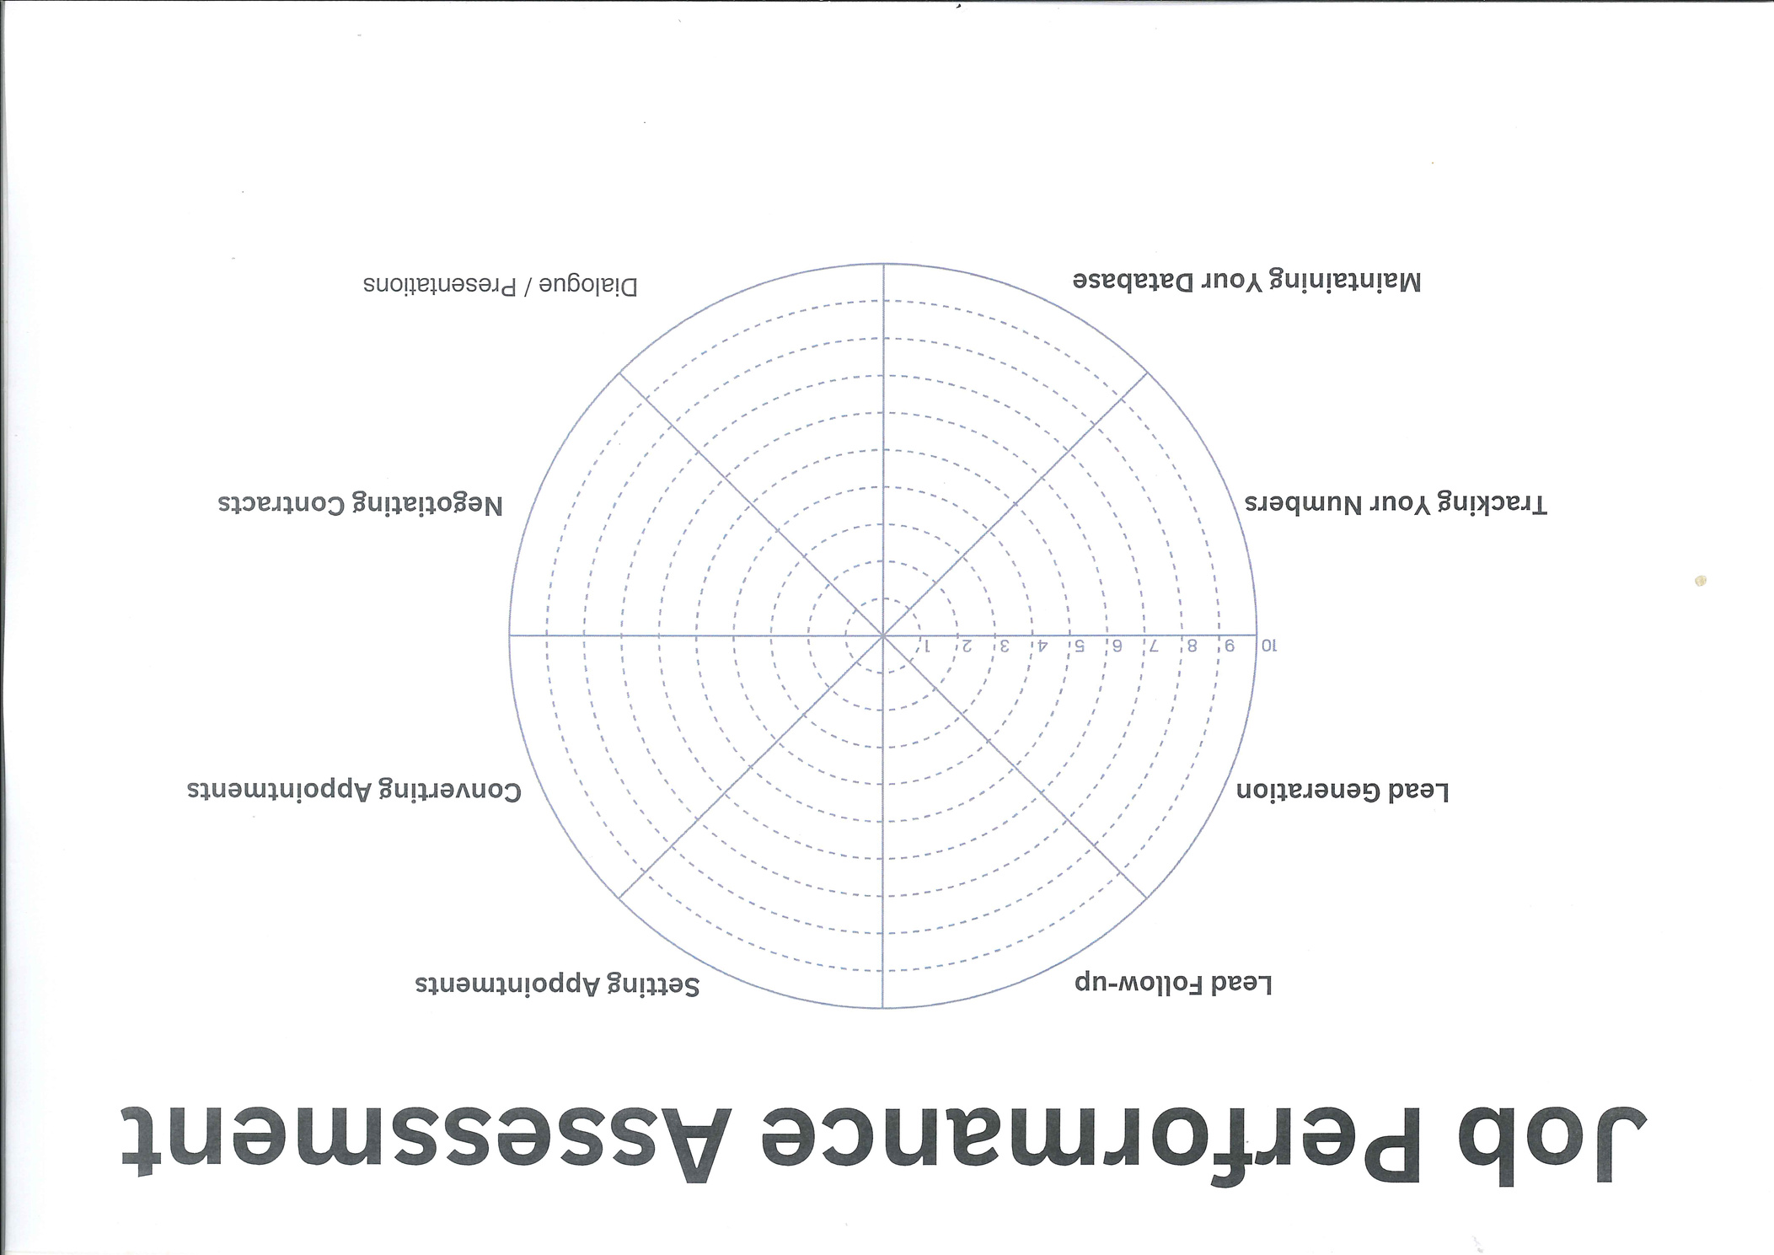
Mid-Year Assessment
(Where I am now.)

Slide 11
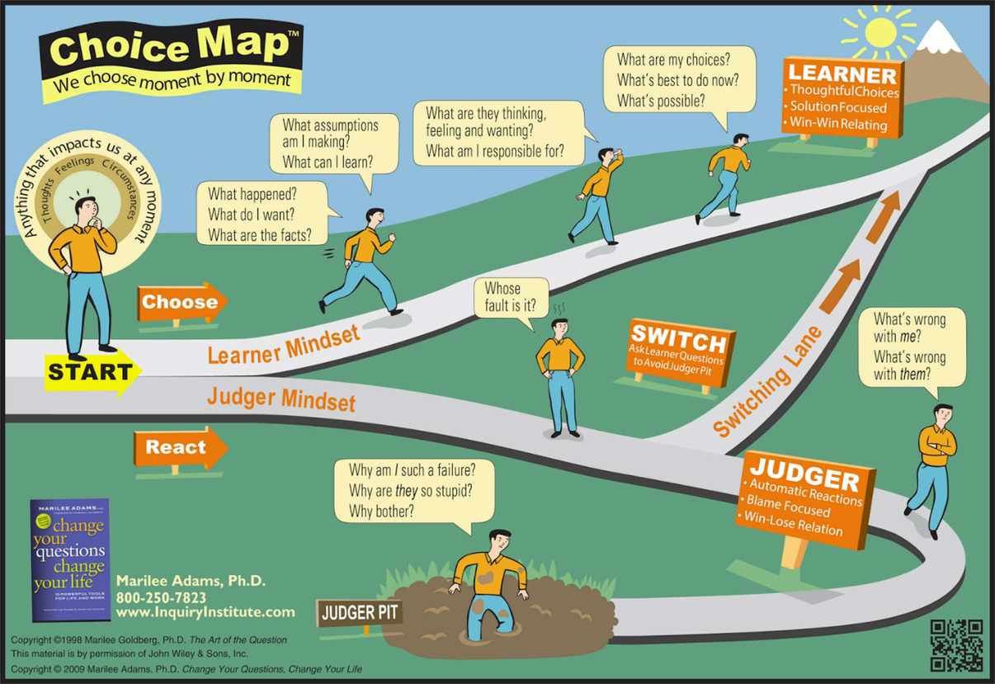
Choice Map

Slide 12
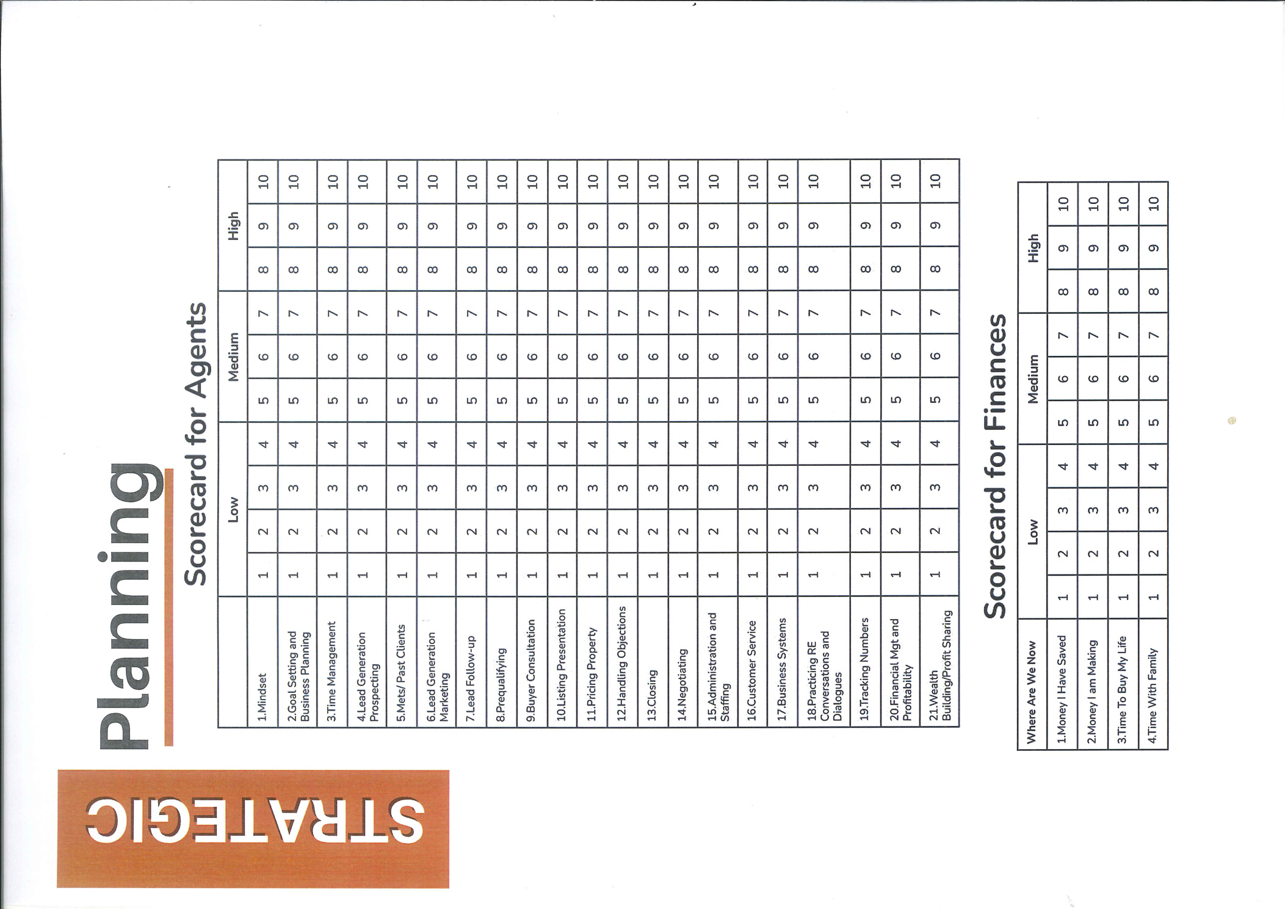
Year-End Planning
(Where I want to be.)

Slide 13
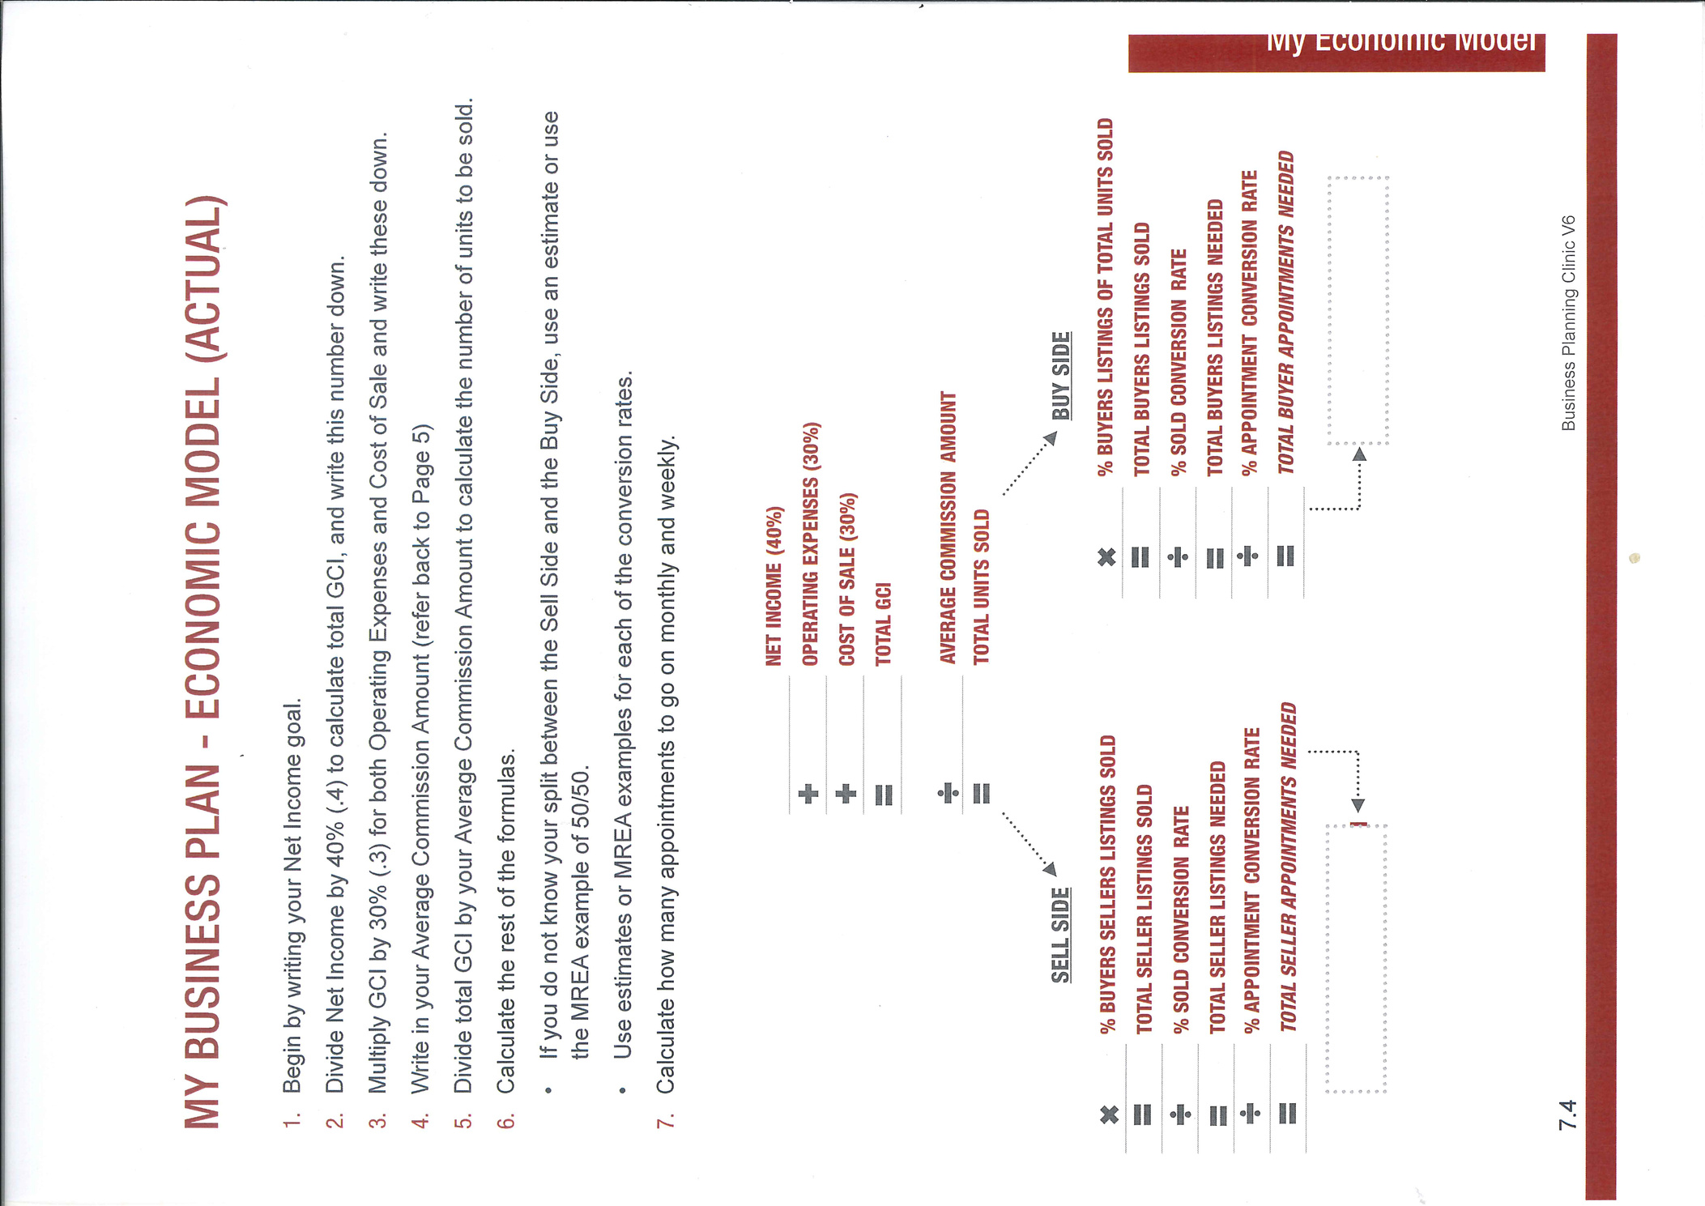
Economic Model

Slide 14
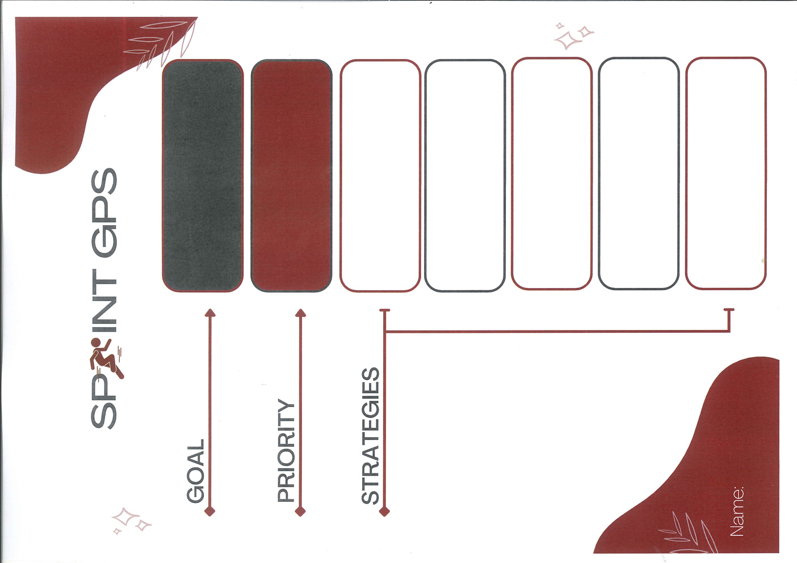
Sprint GPS

Slide 15
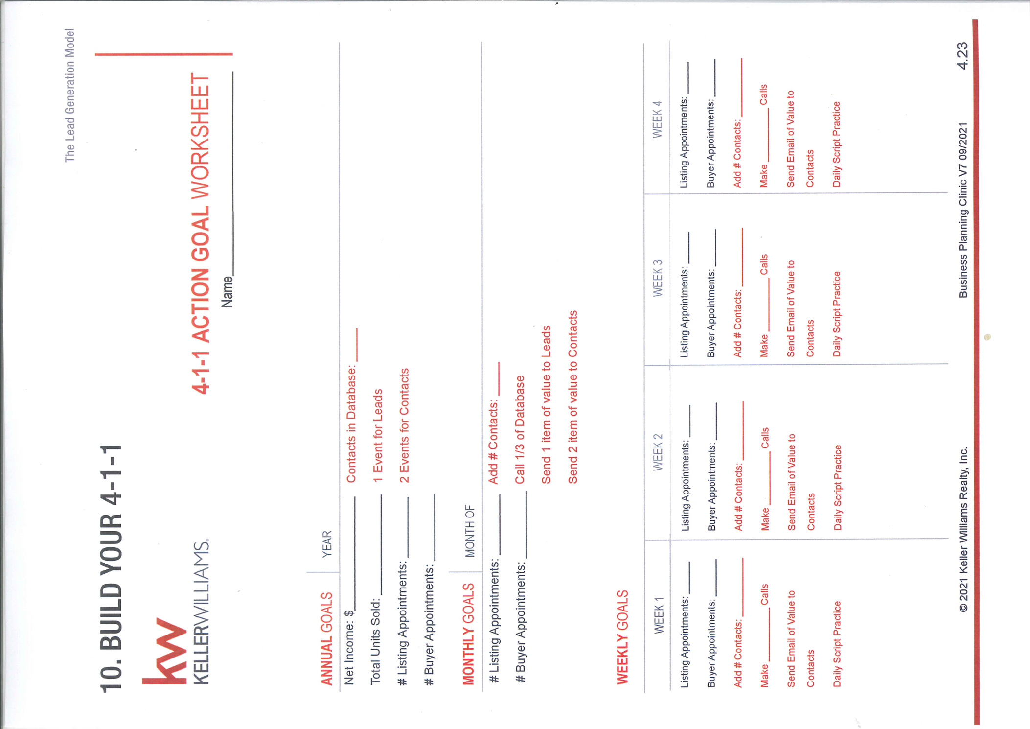
BUILD YOUR 4-1-1

Slide 16







CGI (Career Growth Initiative)
My NAME is
and I
KNOW MY NUMBERS
for the month of
.
THE FOUR CONVERSATIONS
LISTING
LISTINGS
TAKEN
CLOSINGS
PROFIT
APPOINTMENTS
THIS MONTH’S
ACTUAL
WALL OF VALUE
THIS MONTH’S
GOAL

Slide 17
Daily Accountability
I am a COMMITED Real Estate Professional
10 MEANINGFUL CONVERSATIONS (Call or doorknocking)
E-MAILS
WHATSAPP MESSAGES/ SMSES
ADDED TO DATABASE
APPOINTMENTS
LISTINGS TAKEN
OTPS
ACCOUNTABILITY PARTNER:

Slide 18

Recommended Reading

